Slide 1
Deep Learning Introduction
January 2026

Slide 2

¿What is AI?

Slide 3
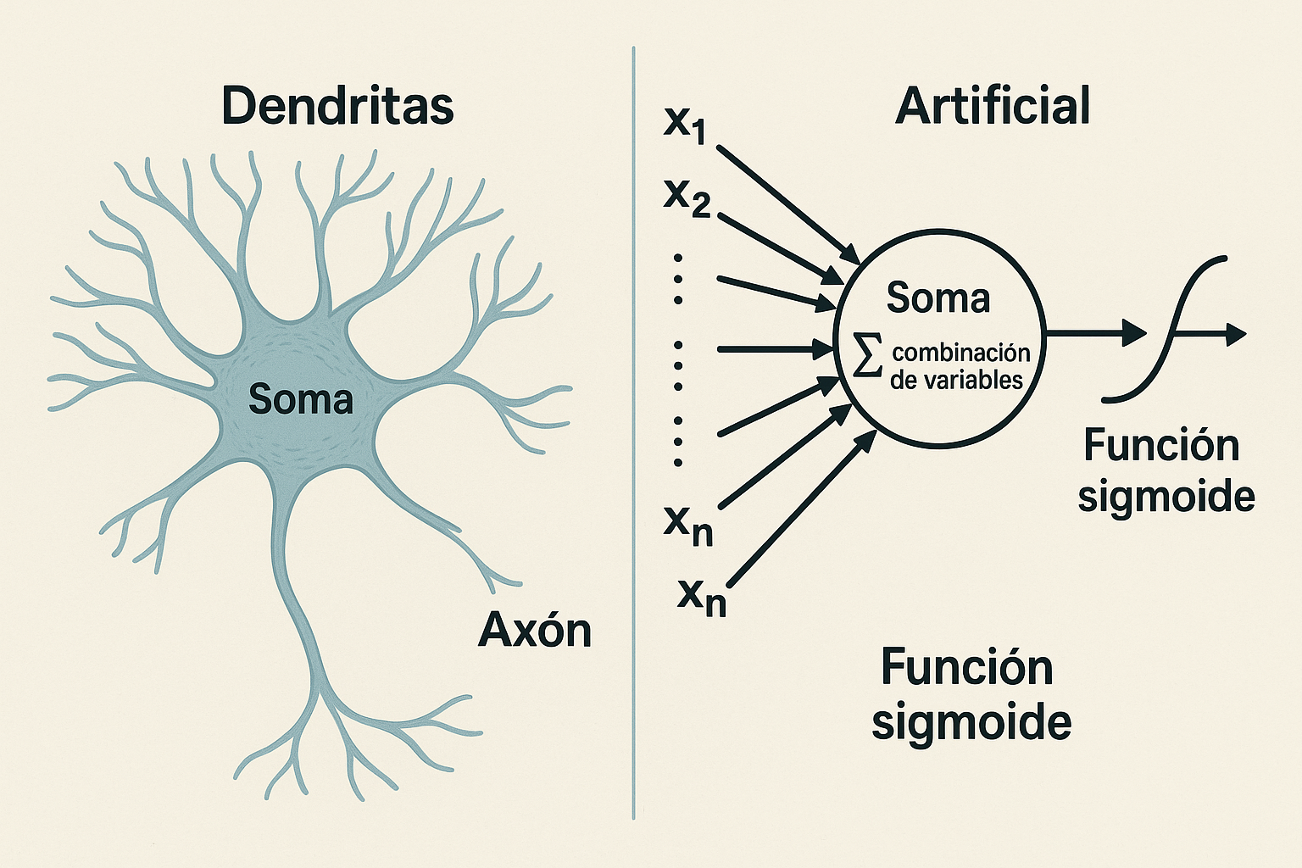
Neuron Functioning

Slide 4

IA-Machine learning
Trial and error
Reward

Slide 5
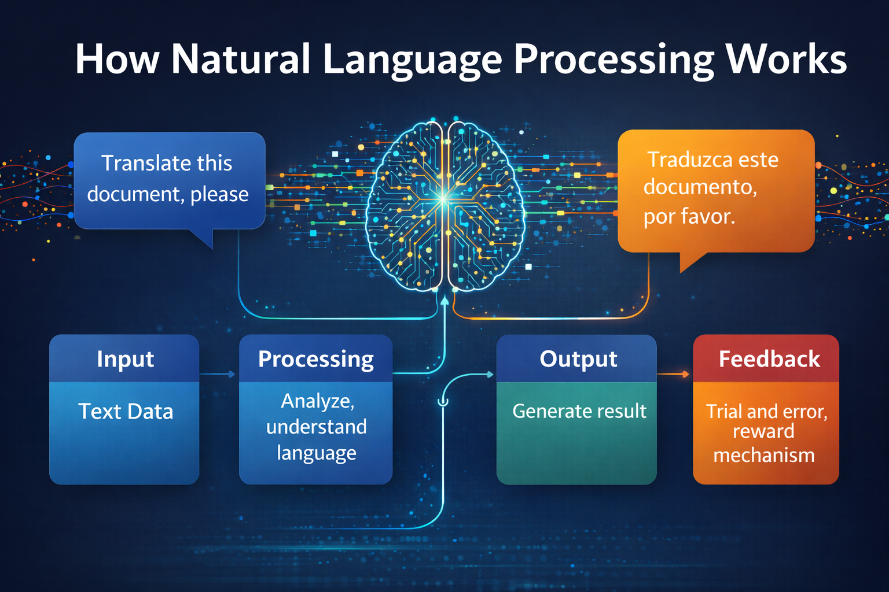
NLP

Slide 6
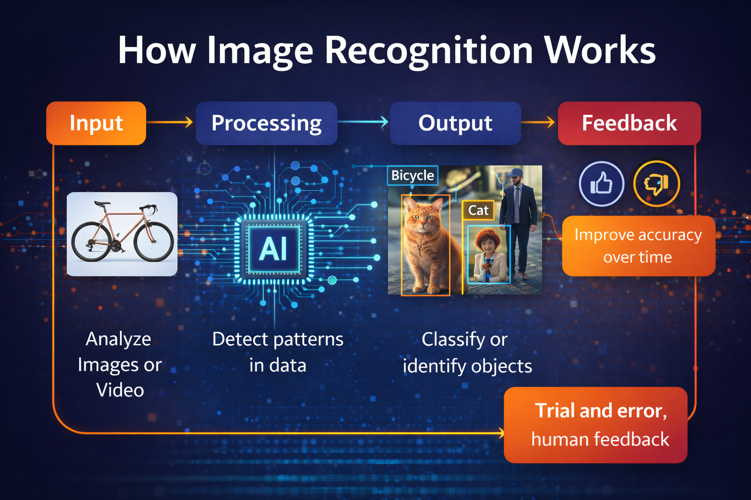
Image recognition

Slide 7

GenAI

Slide 8

IA-Agentic

Slide 9
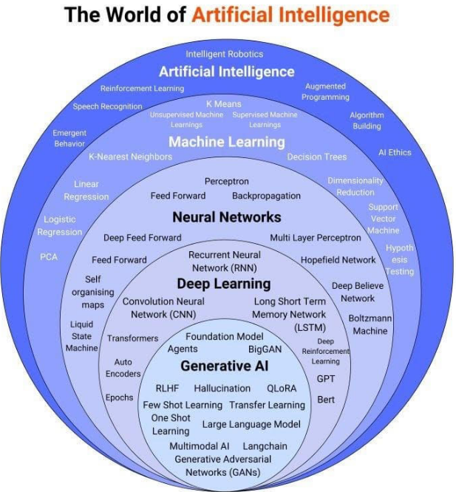
Where is Deep Learning?

Slide 10

What is Deep Learning?
Deep learning is just a modern name for artificial neural networks with many layers. What is deep in deep learning though? It is basically due to the structure of the artificial neural network (ANN). ANN consists of some n number of layers to perform any computation. We can build an ANN with several layers where each layer is responsible for learning the intricate patterns in the data.

Slide 11
What is Deep Learning?
Due to the computational advancements, we can build a network even with 100s or 1000s of layers deep. Since the ANN uses deep layers to perform learning we call it as deep learning and when ANN uses deep layers to learn we call it as a deep network.

Slide 12


Origin of Deep Learning
Depp has its origins in unstructured datasets where extracting features are difficult, such as speech recognition, text classification, image recognition and many more. When we have a fair amount of huge datasets, deep learning algorithms are good at extracting features and mapping the extracted features to their labels.

Slide 13
Deep Learning in Small Data Sets
Although deep learning performs better than conventional machine learning models, it is not recommended to use DL for smaller datasets. When we don't have enough data points or the data is very simple, then the deep learning algorithms can easily overfit to the training dataset and fail to generalize well on the unseen dataset. Thus, we should apply deep learning only when we have a significant amount of data points.

Slide 14
Biological Neurons
A neuron can be defined as the basic computational unit of the human brain. Neurons are the fundamental units of our brain and nervous system. Our brain encompasses approximately 100 billion neurons.

Slide 15
Biological Neurons
Each and every neuron is connected to one another through a structure called a synapse, which is accountable for receiving input from the external environment, sensory organs for sending motor instructions to our muscles, and for performing other activities.

Slide 16
Biological Neurons
A neuron can also receive inputs from the other neurons through a branchlike structure called a dendrite. These inputs are strengthened or weakened; that is, they are weighted according to their importance and then they are summed together in the cell body called the soma. From the cell body, these summed inputs are processed and move through the axons and are sent to the other neurons.

Slide 17
Artificial Neuron (Perceptron)
Perceptrons were invented as simple computational models of neurons. A single neuron typically has many inputs (dendrites), a cell body, and a single output (the axon).
Then, we introduce non-linearity to the result, , by applying a function called the activation or transfer function. Thus, our output becomes:
So, a neuron takes the input, x, multiples it by weights, w, and adds bias, b, forms , and then we apply the activation function on and get the output, .

Slide 18
Activation Functions
An activation function, also known as a transfer function, plays a vital role in neural networks. It is used to introduce non-linearity in neural networks. As we learned before, we apply the activation function to the input, which is multiplied by weights and added to the bias, that is, , where z = (input * weights) + bias and is the activation function. If we do not apply the activation function, then a neuron simply resembles the linear regression. The aim of the activation function is to introduce a non-linear transformation to learn the complex underlying patterns in the data.
The sigmoid function
The tanh function
The Rectified Linear Unit function
The leaky ReLU function
The Exponential linear unit function
The Swish function
The softmax function

Slide 19
Sigmoid Function
The sigmoid function is one of the most commonly used activation functions. It scales the value between 0 and 1. The sigmoid function can be defined as follows:

Slide 20
The Tanh Function
A hyperbolic tangent (tanh) function outputs the value between -1 to +1 and is expressed as follows:

Slide 21
The Rectified Linear Unit function
The Rectified Linear Unit (ReLU) function is another one of the most commonly used activation functions. It outputs a value from o to infinity. It is basically a piecewise function and can be expressed as follows:

Slide 22
The Leaky ReLU Function
Leaky ReLU is a variant of the ReLU function that solves the dying ReLU problem. Instead of converting every negative input to zero, it has a small slope for a negative value as shown:

Slide 23
The Exponential Linear Unit Function
Exponential linear unit (ELU), like Leaky ReLU, has a small slope for negative values. But instead of having a straight line, it has a log curve, as shown in the following diagram:

Slide 24
The Swish Function
The Swish function is a recently introduced activation function by Google. Unlike other activation functions, which are monotonic, Swish is a non-monotonic function, which means it is neither always non-increasing nor non-decreasing. It provides better performance than ReLU. It is simple and can be expressed as follows:

Slide 25
The Softmax Function
The softmax function is basically the generalization of the sigmoid function. It is usually applied to the final layer of the network and while performing multi-class classification tasks. It gives the probabilities of each class for being output and thus, the sum of softmax values will always equal 1.
Class
1
2
3
Probabilities
0.25
0.35
0.40
Softmax

Slide 26
Preguntas?

